Slide 1

E-TALKING BEST FOR YOU
American Conspiracy Theories
Some of America’s Biggest Events – Did They Really Happen?
view

Slide 2

E-TALKING BEST FOR YOU
INTRODUCTION
CEFR Learning Goal: Justify your point of view

Slide 3
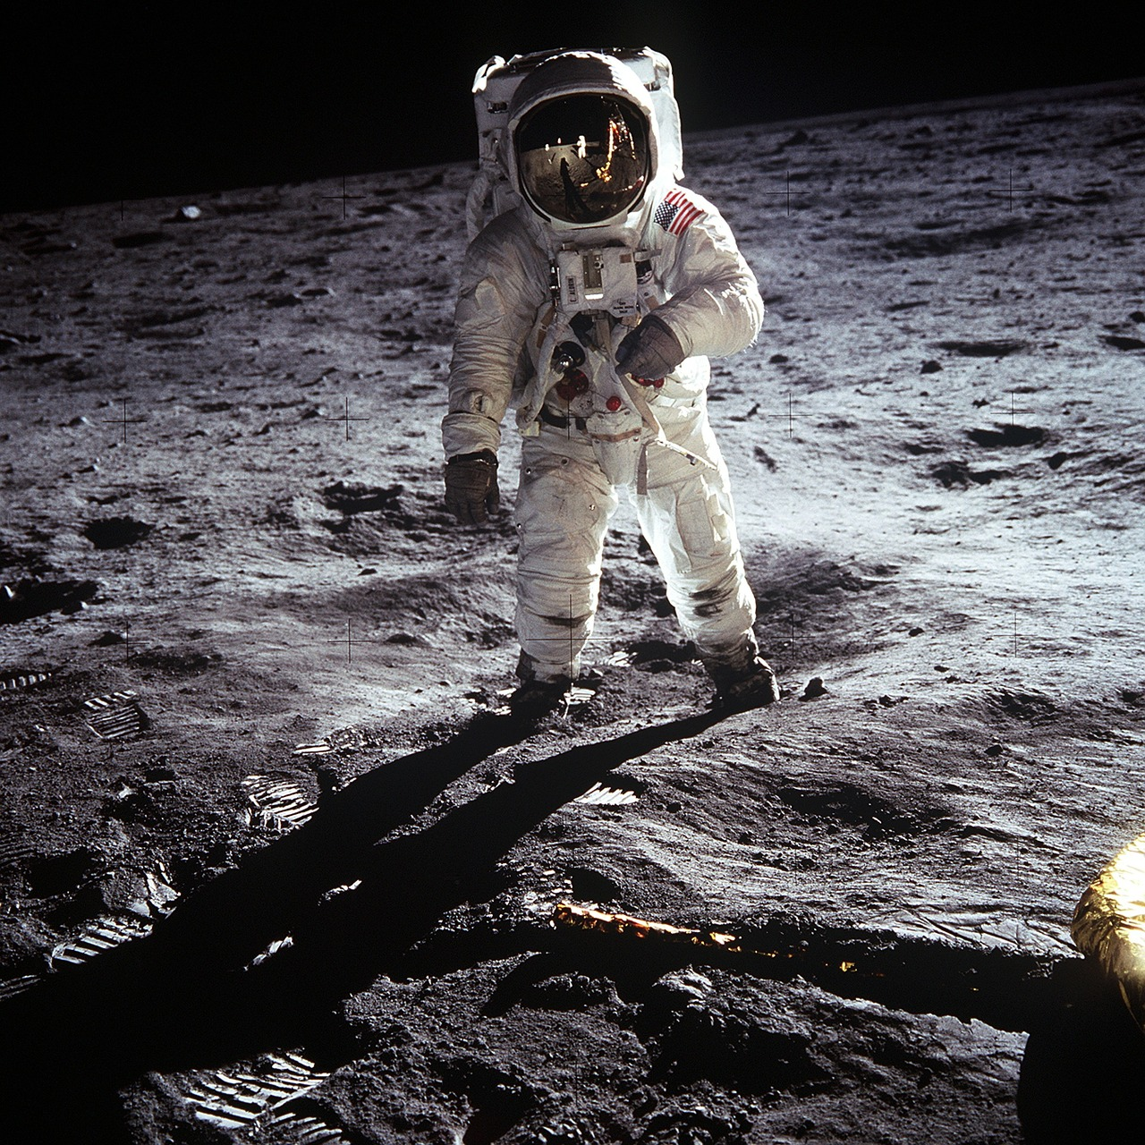
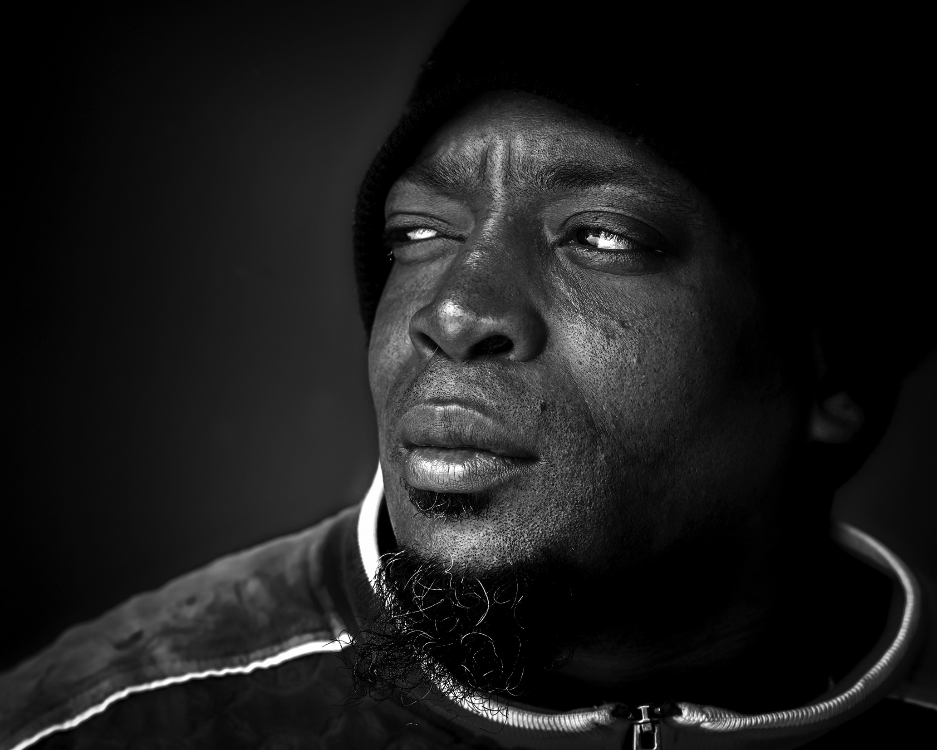
E-TALKING BEST FOR YOU
When bad things happen, people sometimes have trouble believing that it’s true. So they start to doubt that it is true and start asking questions or investigating to see if it is true or not. From these questions and investigations a lot of theories can start to form, these theories are usually called conspiracy theories.
START

Slide 4

E-TALKING BEST FOR YOU
VOCABULARY
Lets check whether you know each following word.

Slide 5

E-TALKING BEST FOR YOU
E-TALKING BEST FOR YOU
Conspiracy-minded (adjective) people that often think unpleasant events or situations are the result of secret plans made by powerful people
Popularity (noun) the quality of being liked by many people
Clues (noun) a sign or a piece of information that helps you solve a problem or answer questions
Evidence (noun) something that makes you believe that something is true or exists
Astronaut (noun) a person trained for traveling in space
Set (noun) the place where a film or play is performed or recorded, and the pictures, furniture, etc. that are used
Vocabulary

Slide 6
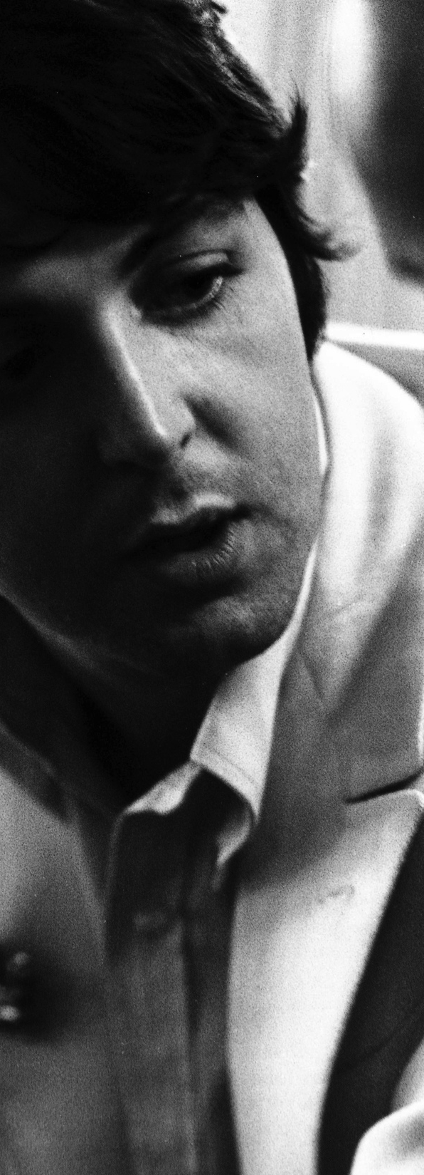
E-TALKING BEST FOR YOU
Paul McCartney’s Death
Paul McCartney was one of the most famous American singers of all time. He sang for many years for the popular English rock and roll band, The Beatles. Conspiracy-minded people think that Paul actually died in 1966. They feel that The Beatles did not want to make his death public. So instead of telling everyone that he died, they think the band chose another band member that sang like Paul, looked like him, and even acted like him. People think the band was afraid to lose its popularity if Paul wasn’t a member anymore. The same people also believe The Beatles started leaving clues or hints in their music. An entire group of people call themselves Paul-is-Dead. They have regular meetings to help find evidence that he actually died in 1966.

Slide 7

E-TALKING BEST FOR YOU
DISCUSSION
Do you know anyone who is very conspiracy-minded?
Tell the class about him or her.
Do you like talking to or listening to people like that?

Slide 8
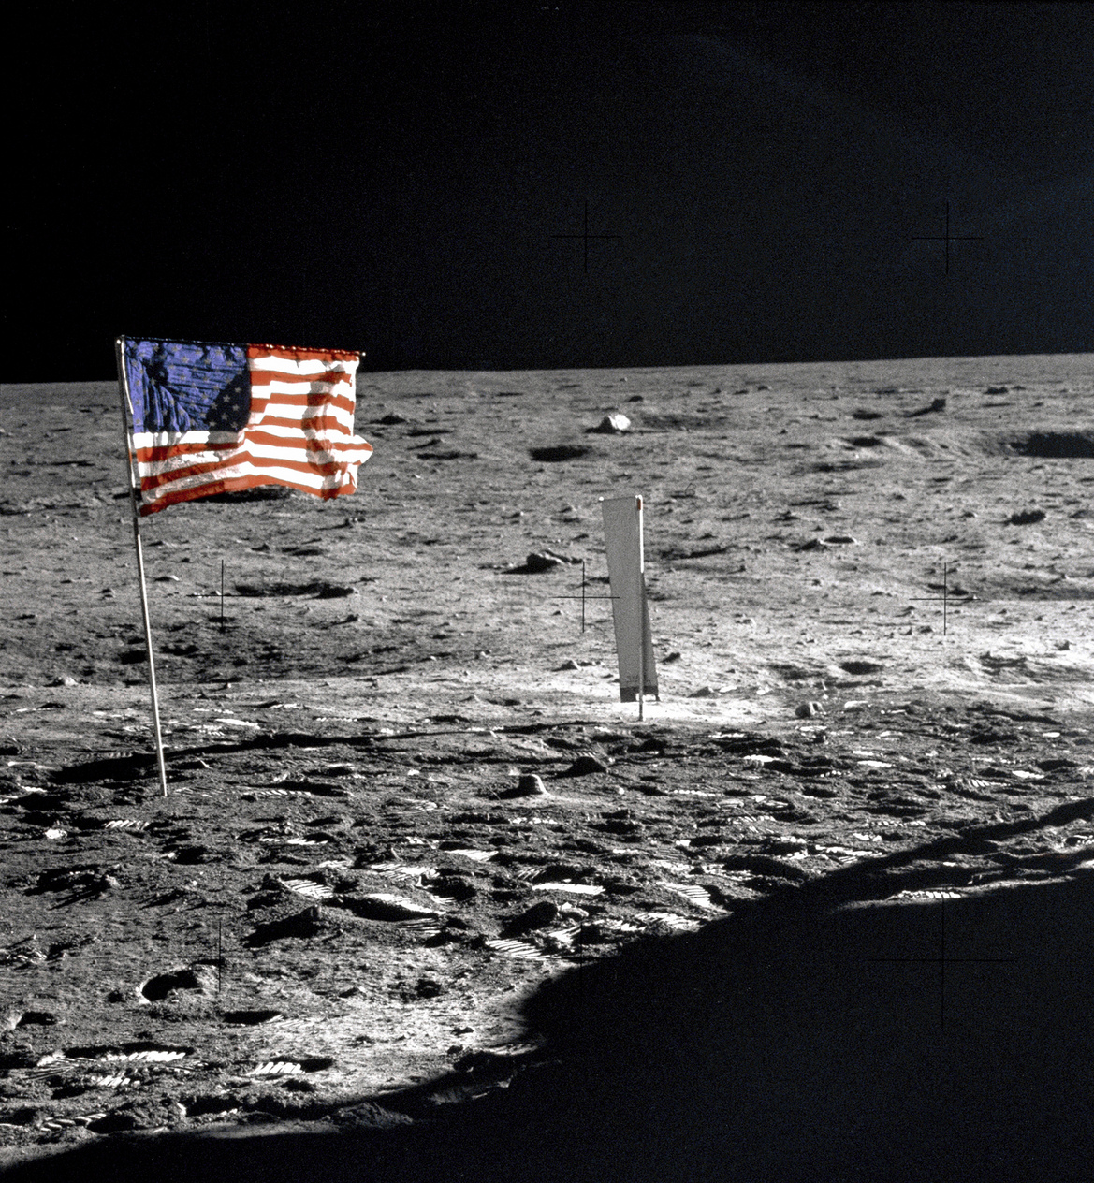
E-TALKING BEST FOR YOU
Landing on the moon
Neil Armstrong, a famous American astronaut, stepped on the moon in 1969. Many people think that the U.S. government made up this whole event. They think that America was worried about Russia getting on the moon first. They believe the whole event took place somewhere on a very special movie set in Hollywood. Their theory is based on the fact that the American flag is waving in the background of the film.

Slide 9
E-TALKING BEST FOR YOU
DISCUSSION
Do you think there are many theories around space travel?
Why would space travel raise more questions than other travels or events?

Slide 10
E-TALKING BEST FOR YOU
REVIEW DISCUSSION
Think about the conspiracy theories you learnt about or talked about during this lesson. Choose one and discuss it in detail with your partner. You can use one from this lesson or a movie, book, TV series, etc. Choose one conspiracy theory for your next activity, make sure you have enough information to talk about it.

Slide 11

E-TALKING BEST FOR YOU
SPEAKING TASK
Choose one team to present their conspiracy theory. One member has to argue why the conspiracy theory is true, the other should say why it isn’t. The rest of the class should ask them questions to see if they can decide if it is just a theory or not.

Slide 12

E-TALKING BEST FOR YOU
ASSESSMENT

Slide 13

E-TALKING BEST FOR YOU
True or False
Some people believe that The Beatles started leaving clues in their music regarding Paul McCartney’s death. T/F
Neil Armstrong was the fifth person to step on the moon. T/F
Conspiracy-minded people think that Neil Armstrong did not actually land on the moon. T/F
Paul McCartney was a famous American president. T/F
ASSESSMENT

Slide 14


E-TALKING BEST FOR YOU
Thank you !

